Slide 1

Trulia Price Prediction US
By Jun Chen

Slide 2

US Housing Market
One of the biggest industries in the country, worth 33 trillion dollars.
Statista reports that Trulia was the second most popular real estate website, receiving about 23 million unique monthly visits as of January 2020.

Slide 3
Methods
Data Cleaning and analysis
Data Exploration
Hypothesis Testing
Machine Learning
Linear Regression
Random Forest Regresion

Slide 4
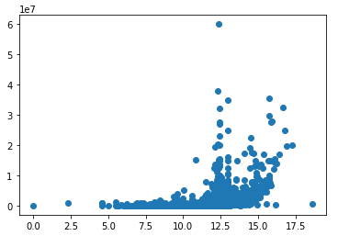
Initial Findings
Based on my EDA the following variables are expected to have an significant effect on my analysis.
Last Sold Price
Graph on right depicts the log transformation of our Last Sold vs Price scatterplot
Number of Bathrooms
Number of Bedrooms

Slide 5
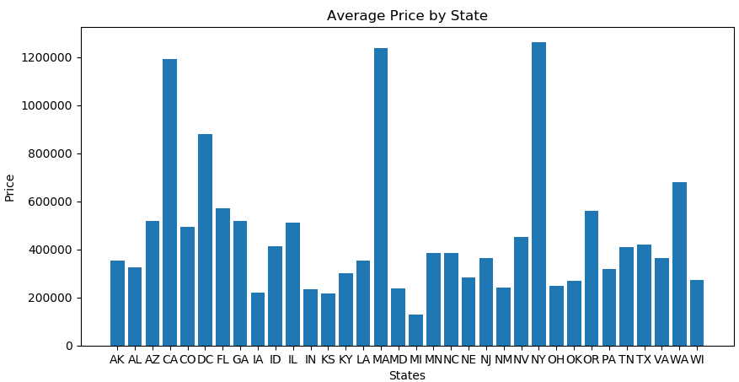
Most Expensive States by Average Home Prices
Based on our analysis, the top five locales with the most expensive homes are:
New York
Massachusetts
California
Washington DC
Washington

Slide 6
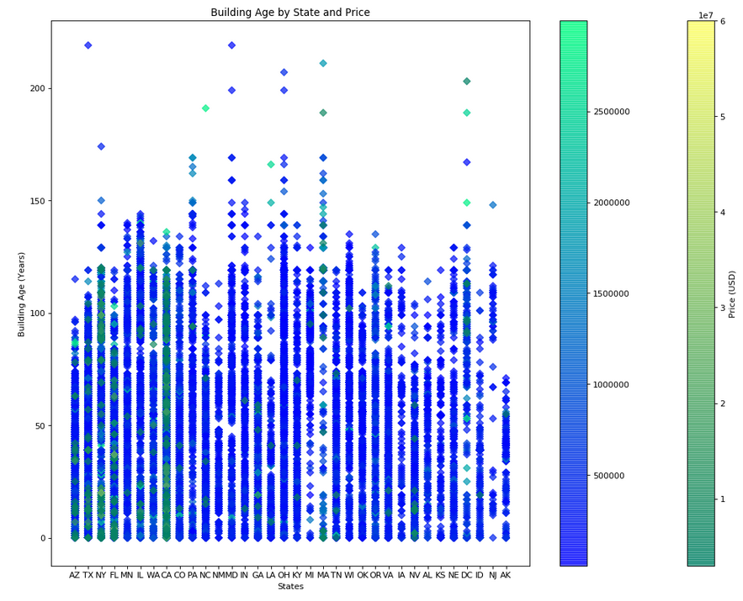
Affect of Building Age on Price by State
For some states older homes generally retain a higher value than newer ones.
North Carolina,
Louisiana
Pennsylvania
For other states Building Age has no affect on housing prices
California
New York
Florida

Slide 7
Statistical Analysis – Hypothesis Testing
The general consensus from most Americans is that the major states (in our case New York, Texas, and California, the top three states in terms of GDP representing 31.4 % in the first quarter of 2020), have a higher cost of living and thus the housing prices are bigger.
The null hypothesis (Ho)is that there is no difference in price between our top three states and the rest of the country
The alternative hypothesis (H1) is that there is in fact a price difference in the homes for the top three states and the rest of the country

Slide 8
Statistical Analysis – Hypothesis Testing
To complete the analysis, I pulled data from the ‘Price’ column of the data set, and separated it by the States NY, CA and TX and the rest of the country. Removing these three states , using “big_states = df.Price[df.State.isin(['CA', 'TX', 'NY'])]” and “small_states = df.Price[df.State != 'CA'][df.State != 'TX'][df.State != 'NY']”.
For my analysis I know that we only have a sample for the complete Trulia Dataset, and thus I will use the T score instead of the Z score. To complete this process I used the function “stats.ttest_ind”.

Slide 9
Statistical Analysis – Hypothesis Testing Results
After running our formula, the results we received was tstat = 24.33266350950908, with a p value of 1.596 e^-129.
Interpreting our results, due to the small p value, we will reject the null hypothesis here that the cost is the same in the large states of New York, California, and Texas compared to the rest of the country.
In terms of our analysis we can conclusively say that there is a difference in cost between buying a home in New York, California and Texas compared to the rest of the country.

Slide 10
Results and In-Depth Analysis Linear Regression Model
Machine Learning with Linear Regression
Variables used [['Longitude', 'Latitude', 'Beds', 'Bath', 'Sqr_Ft', 'Lot_Size','Last_Sold_For', 'Last_Tax_Assessment', 'Days_On_Trulia’, Time_Since_LS, Buildingj_Age]
Highest individual score when testing the variables against the target, was our bath variable with .1899, but the rest did not score nearly as high.
Multivariate Linear Regression model performed on the base variables without processing our NLP test data columns (Title, Description, Features, Facts) gave an R2 score of 0.331 for the Test Set and 0.265 for the Training Set

Slide 11

Results and In-Depth Analysis NLP Data Processing
To convert our text data to usable numeric data here we will use the SpaCy model.
Factors to look at is which size model we want to use as SpaCy offers a sm, md and lg, option which differ on computation powers and results.
To test, I will run each of the different sizes on our text variables (Title, Description, Features, Facts) concat them to our data frame and run linear regression to check the accuracy for the best ones.

Slide 12
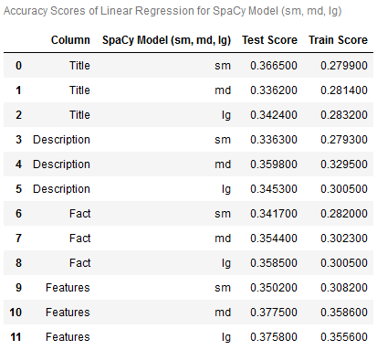
Results and In-Depth Analysis Best SpaCy Models
Title - lg
Test Score 0.3424
Train Score 0.2832
Description - md
Test Score 0.3598
Train Score 0.3295
Fact - lg
Test Score 0.3585
Train Score 0.3005
Features - md
Test Score 0.3775
Train Score 0.3586

Slide 13
Results and In-Depth Analysis Linear Regression
After concatenating all 4 variables into my base dataset, the new dataset has 30006 observations, with 1257 variables.
Running a Multivariate Regression with this new dataset, gave an Test score of 0.392 and a Train score of 0.424. The R2 score did increase by a modest 0.06 but I had expected a bigger increase.

Slide 14
Results and In-Depth Analysis Random Forest Regression
Parameters that were tuned
Number of estimators (trees)
100
300
500
Max Features
Auto
Sqrt
Log2
Min Samples Leaf
10
30
50

Slide 15
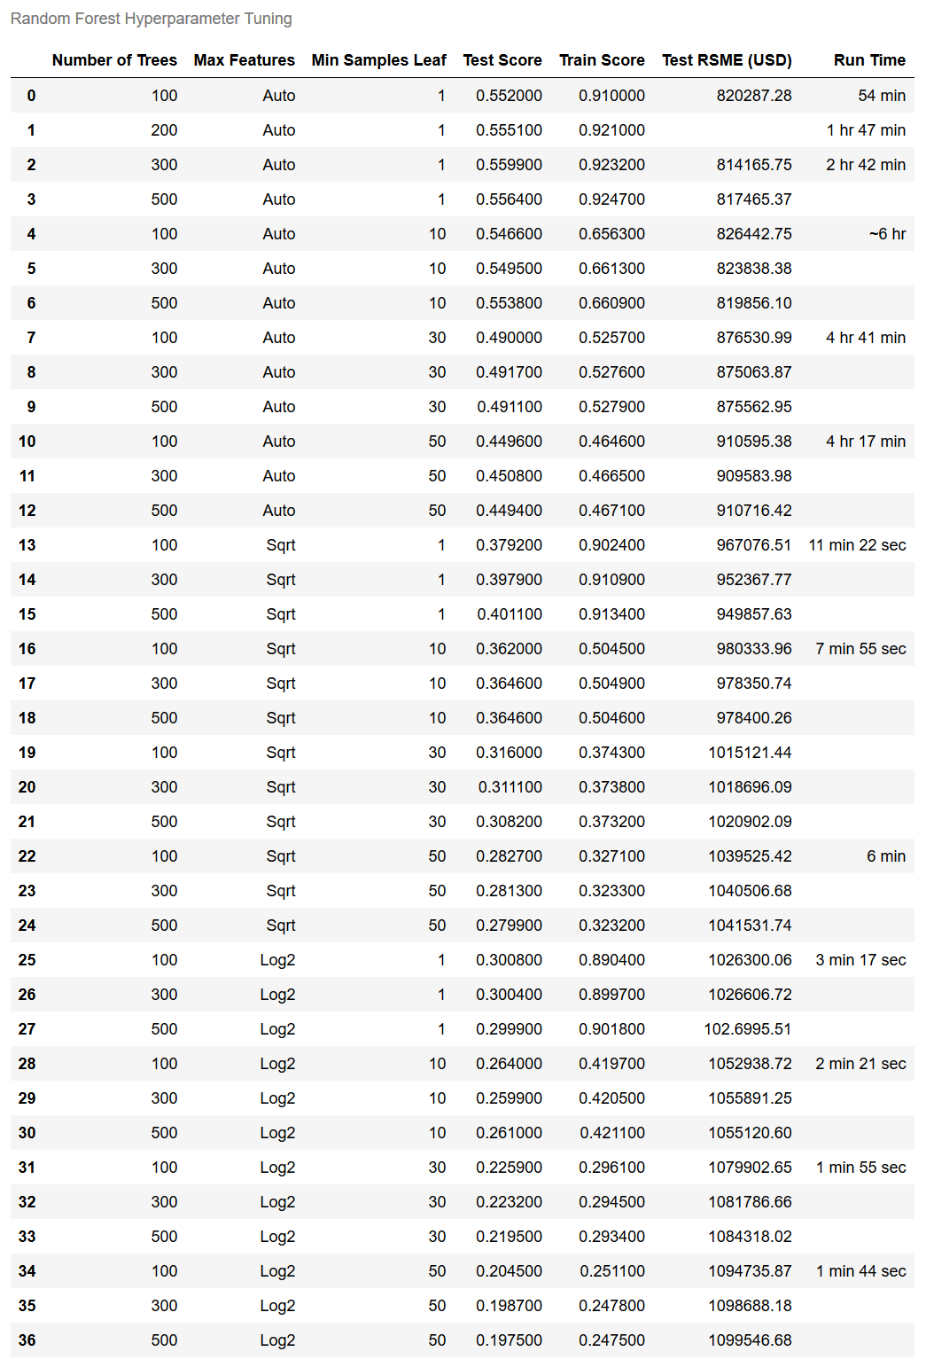
Results and In-Depth Analysis Hyperparameter Tuning Table
Based on the tuning I did in the Random Forest Regression model, the best test score was .4917 with a train score of 0.5276.
Ideal parameters were 300 trees, Max Features being set to Auto, and Min Samples Leaf set to 30
Issues that arose included the computing time needed. Due to the size of our model, our base Random Forest Regression ran at approximately 54 minutes per tree
This is why I took run time as an consideration in the table

Slide 16
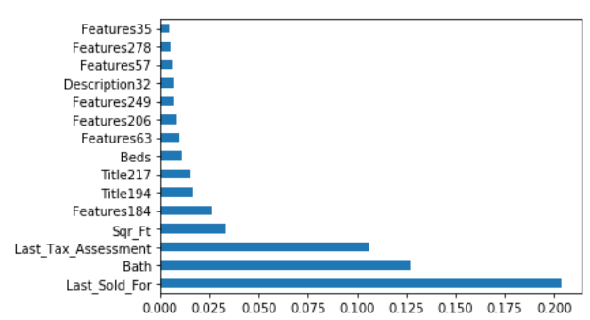
Insights
Employing .coef_ and .feature_importance_ on my Linear Regression and Random Forest Regression models provided some valuable insights.
We can see that the Bath variable had a .coef_ of 206,276.46 USD, meaning that for every bathroom a listing has, you can expect an 206,276.46 USD increase in cost for that home.
For the Sqr_Ft variable, you can see that for every square foot of the unit there is an increase of 0.08 USD. So generally the bigger the unit the more expensive it will be.
Reviewing the Feature Importance bar graph below, we can see that the top 5 variables in determining price were:
Last Sold For
Bath
Last Tax Assessment
Sqr Ft
Beds

Slide 17
END

